Slide 1
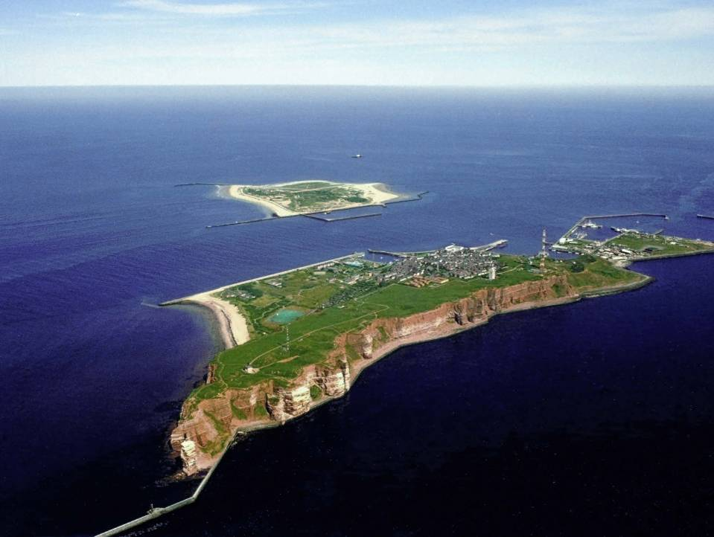
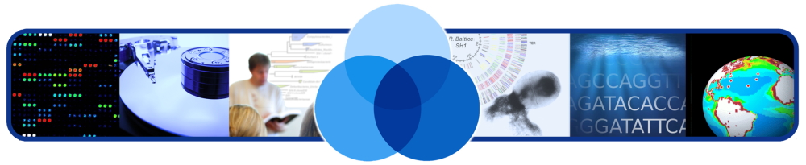
Micro B3 Information System Bringing sequence data into environmental context
Microbial Genomics and Bioinformatics Research Group
Renzo Kottmann
rkottman@mpi-bremen.de @renzokott
Hinxton, 2014-03-27

Slide 2
Ecosystem Perspective

Slide 3
Data Perspective
genomes
metagenomes
latitude
collection date
transcriptomes
longitude
depth
marker genes
proteomes
water currents
temperature
Omics Data
Environmental Data

Slide 4
Data Perspective
genomes
metagenomes
latitude
collection date
transcriptomes
longitude
depth
marker genes
proteomes
water currents
temperature
Omics Data
Environmental Data
Result: Relationship

Slide 5
Data Flow Perspective
genomes
metagenomes
latitude
collection date
transcriptomes
Knowledge
Study
longitude
depth
marker genes
proteomes
water currents
Web Access
Field
temperature
Omics Data
Environmental Data
Integration
Result: Relationship
Laboratory
Archival
Computing

Slide 6
Data Flow Perspective: Issues
genomes
metagenomes
latitude
collection date
transcriptomes
Knowledge
Study
longitude
depth
marker genes
proteomes
water currents
Web Access
Field
temperature
Omics Data
Environmental Data
Quantity Heterogeneity
Complexity
Integration
Laboratory
Archival
Computing

Slide 7
Data Integration
genomes
metagenomes
latitude
collection date
transcriptomes
Knowledge
Study
longitude
depth
marker genes
proteomes
water currents
Web Access
Field
temperature
Omics Data
Environmental Data
Data Integration + Analysis
Integration
Result: Relationship
Laboratory
Archival
Computing

Slide 8
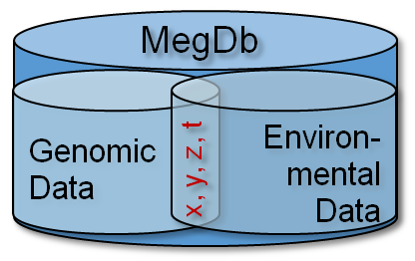
Data Integration: Geo-referencing
genomes
metagenomes
y = latitude
t = collection date
transcriptomes
Knowledge
Study
x = longitude
z = depth
marker genes
proteomes
water currents
Web Access
Field
temperature
Omics Data
Environmental Data
Data Integration + Analysis
Integration
Result: Relationship
Laboratory
Archival
Computing

Slide 9

Micro B3: Biodiversity, Bioinformatics, Biotechnology
Knowledge
Study
Web Access
Field
Integration
Laboratory
Archival
Computing

Slide 10
Micro B3: Biodiversity, Bioinformatics, Biotechnology
Micro B3 Information System

Slide 11
Definition: Information System
information system, an integrated set of components for collecting, storing, and processing data and for delivering information, knowledge, and digital products. (http://www.britannica.com/EBchecked/topic/287895/information-system, last visit 2013-03-13)

Slide 12
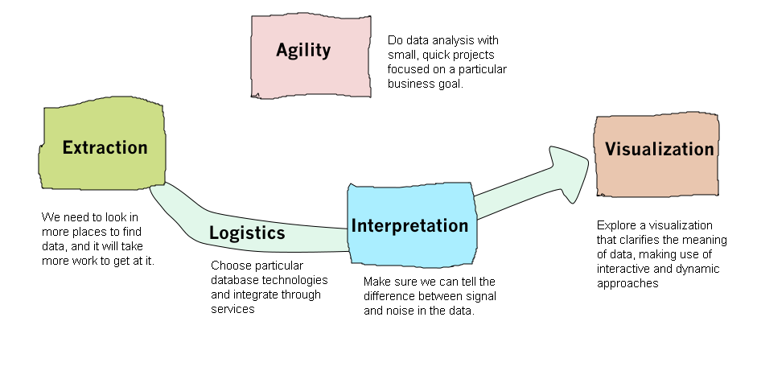
Information System: Logic View
Collecting storing, and processing data and for delivering information
modified from http://martinfowler.com/articles/bigData/

Slide 13
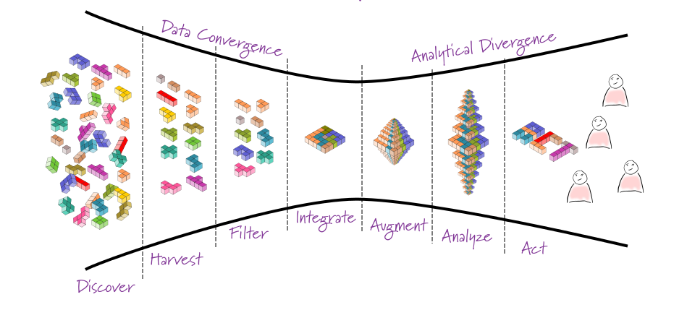
Information System: Process View
modified from http://martinfowler.com/articles/bigData/

Slide 14
Information System: Process View – Data Convergence
How to combine heterogeneous data?
How to gain useful data?
How to gather data?
How to find relevant data?

Slide 15
Information System: Process View – Data Divergence
How to enhance data?
How to find relevant patterns?
How to visualize and operationalize information for knowledge creation?

Slide 16
Information System: Science driven
Which data? How to process and analyze?
What is the geographic and environmental distribution of my gene?
Scientists
Generate +
= knowledge
How to visualize and operationalize information for knowledge creation?

Slide 17
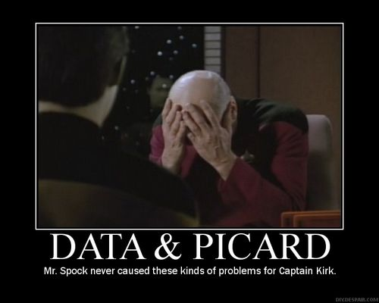
So why all that?
To paraphrase Captain Kirk in the Star Trek:
“Data is a messy business— a very, very messy business.”
episode “A Taste of Armageddon”
“… as much as 60 percent of the time I spend on data analysis is focused on preparing the data for analysis.“
R in Action: Data analysis and graphics with R by Robert I. Kabacoff

Slide 18
Gathering & Services
Data Tracking
Data Services
How to track the geographic- and environmental origin of DNA sequence data?
How to analyze, visualize and interpret the sequence data in an environmental context?

Slide 19
Information System: Science driven
Which data? How to process and analyze?
What is the geographic and environmental distribution of my gene?
Scientists
Generate +
= knowledge
Data Tracking:
OSD App
OSD Server
Data Services:
Workflows
EATME
ProX

Slide 20
Part I: Data tracking Generate, Harvest and Filter

Slide 21
Generate

Slide 22





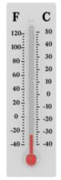



Global Sampling Event
Orchestrated
Contexual Data
Fixed in Time
June 21st 2014
Standardized Protocols
Microbial Diversity & Function
www.oceansamplingday.org
Legal Framework
ABS, MTA, DTA
Notes:
Legal framework
Access and benefit sharing
Model agreements

Slide 23




Ocean Sampling Day
Global
Standardized
Orchestrated
Sampling event fixed in time
June 21st 2014
www.oceansamplingday.org

Slide 24
Information System: Process View
Scientists
Generate +
= knowledge

Slide 25
Harvest

Slide 26

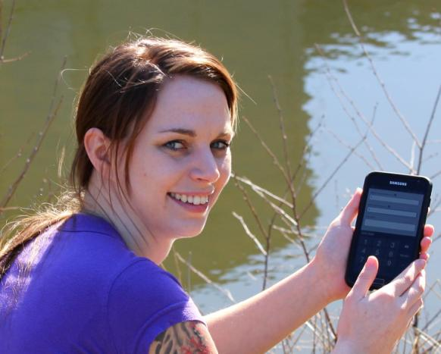
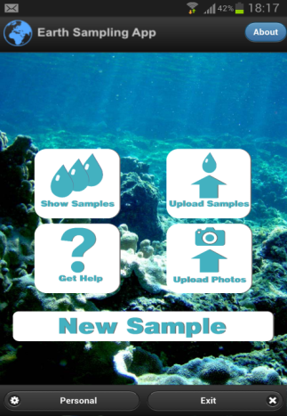


Ocean Sampling Day App
Early, consistent, digital acquisition of environmental data
https://itunes.apple.com/us/app/osd-citizen/id834353532?mt=8
https://play.google.com/store/apps/details?id=com.iw.esa
Notes:
Android / iphone logos

Slide 27
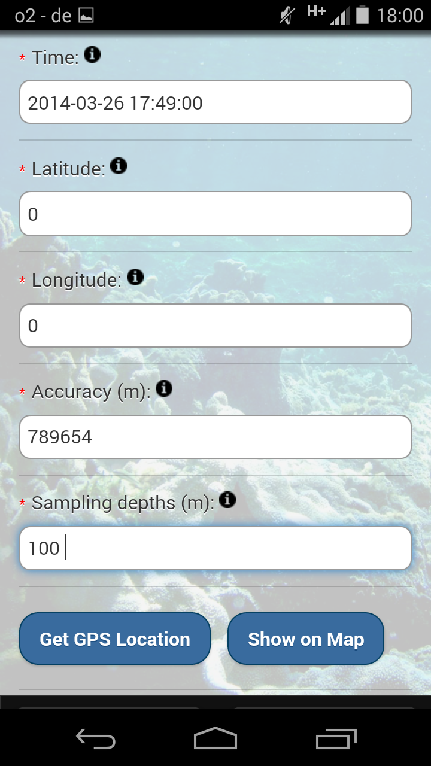
Features
Allows to take data in the field
NO internet connection needed
GSC standards compliant

Slide 28

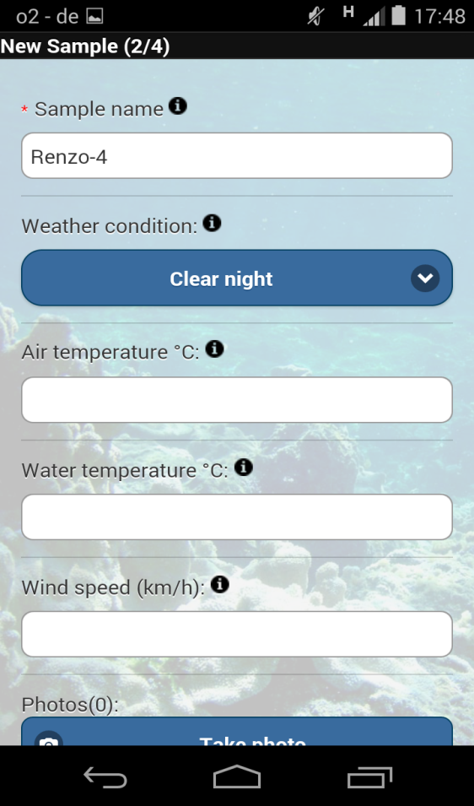
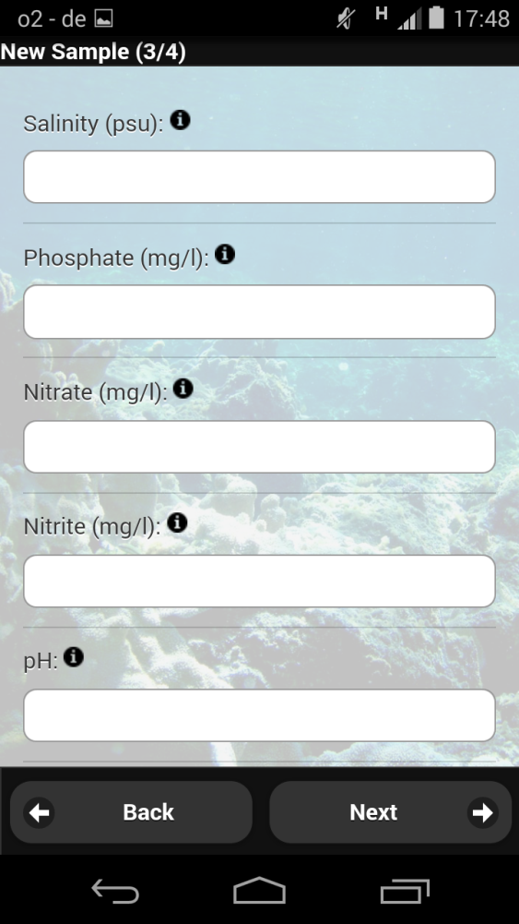
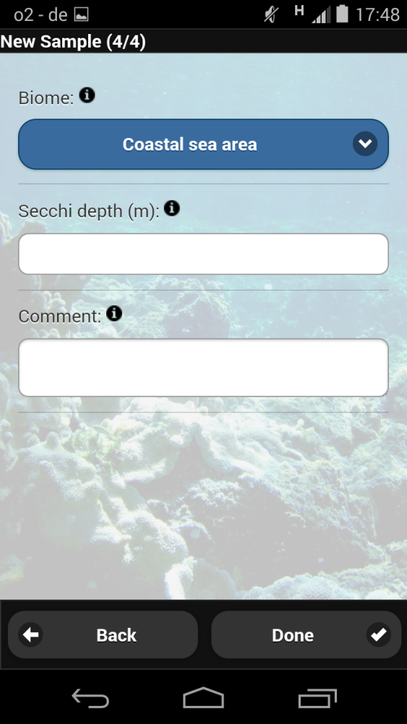
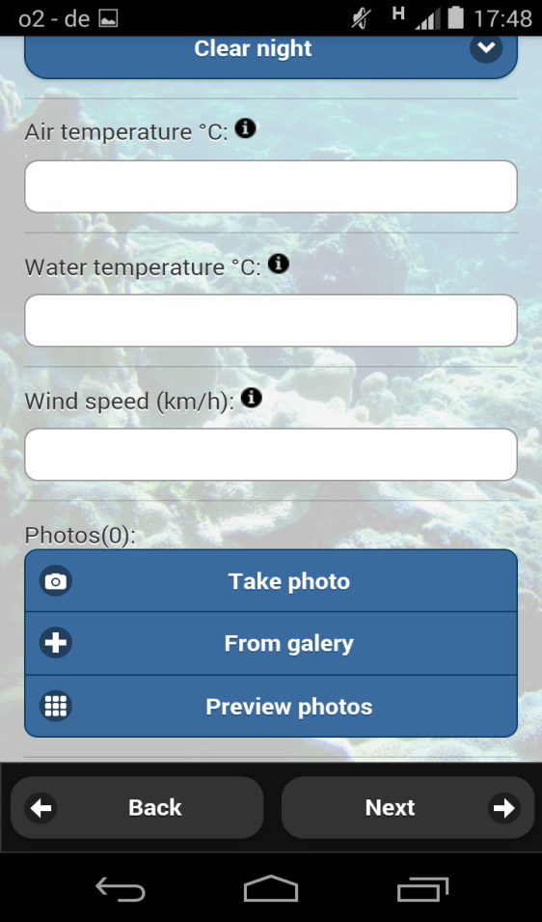
Entering Data

Slide 29
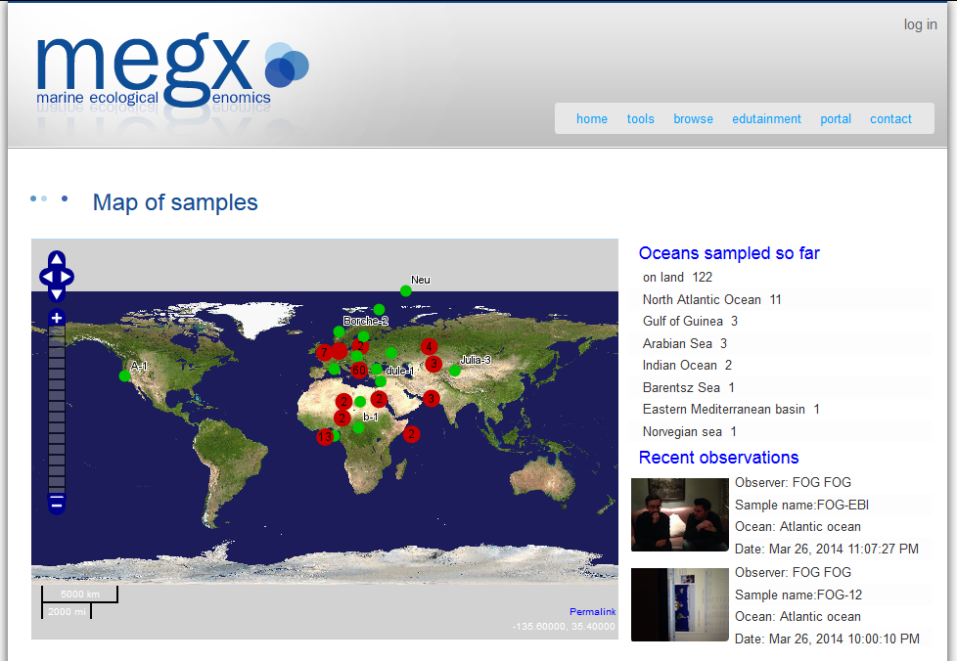
OSD-App-Server

Slide 30
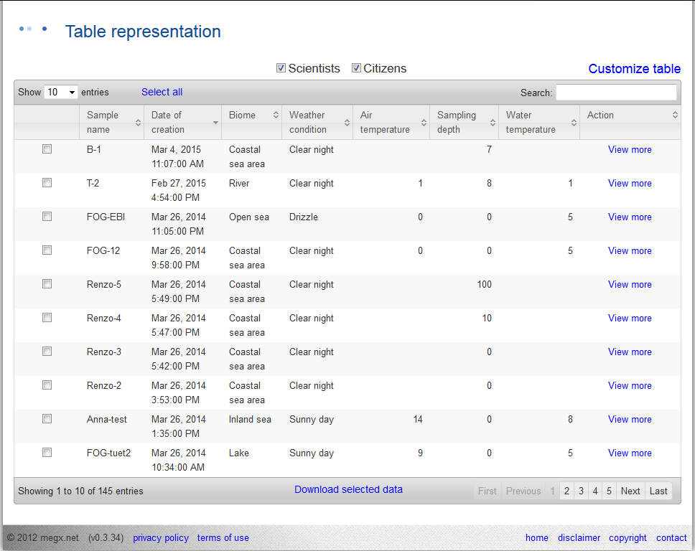
OSD-App-Server

Slide 31
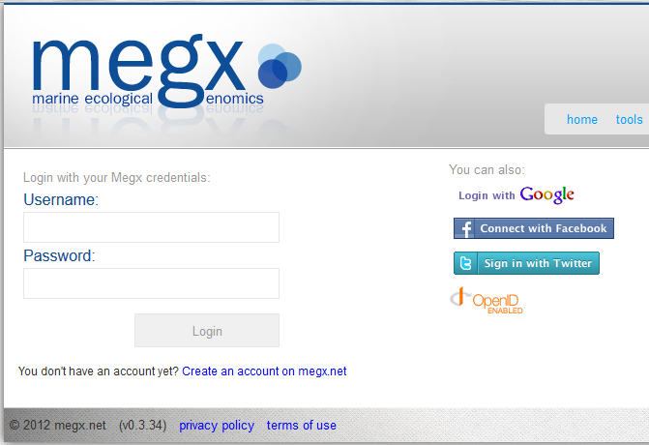
Login: Please Use Twitter, Facebook, or Google
Advantage
You do not need another password
We do not get your password
Out of order
Just works

Slide 32

Information System: Process View
Scientists
Generate +
= knowledge

Slide 33
Filter

Slide 34
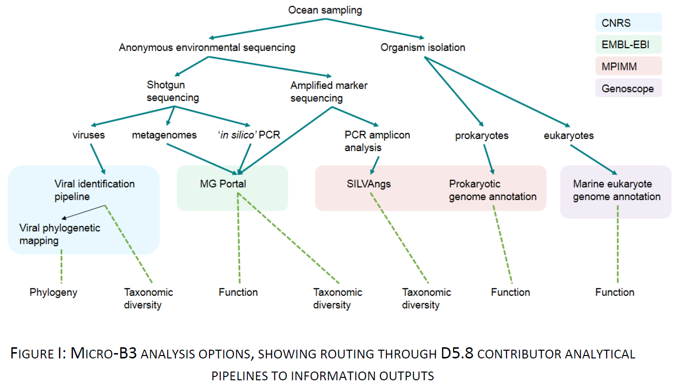
Data Analysis in Micro B3

Slide 35
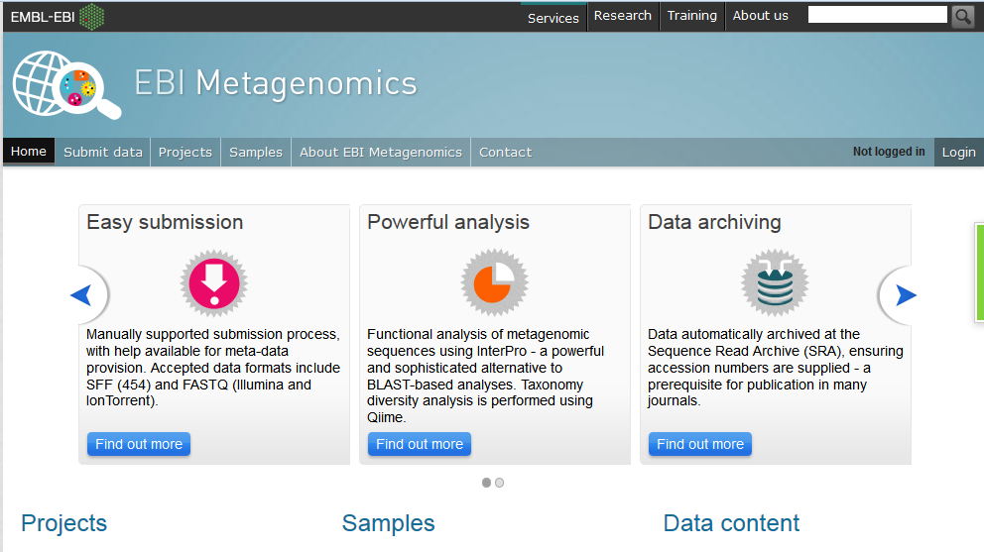

Slide 36

www.arb-silva.de/ngs
Notes:
Core features everybody needs
Overview about your data
Transform into
Service
Reliable
Stable
Web
Easy to use
Product not a prototype

Slide 37
Information System: Process View
Scientists
Generate +
= knowledge

Slide 38
Integrate

Slide 39
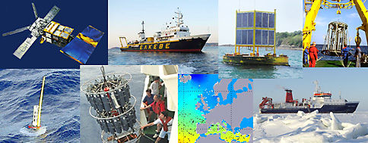



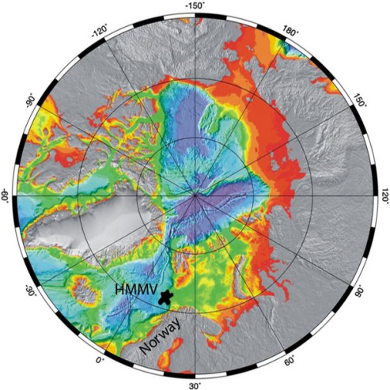
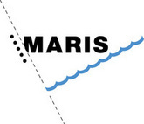




Heterogeneity: Oceanographic Data
Notes:
Black Sea
Chlorophyl A

Slide 40
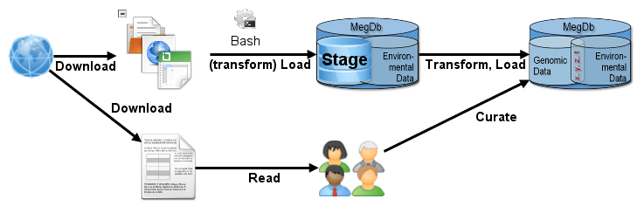
ELT

Slide 41
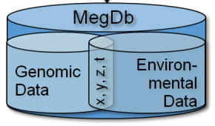
Database Development
PostBIS (Hamburg University)
Efficient storage and retrieval of DNA sequence data
<2 bits per nucleotide base
500x faster substring operation
rasdaman (Jacobs Unveristy)
Store and retrieve multi-dimensional raster data of unlimited size
Enhancements to SQL interface
http://rasdaman.eecs.jacobs-university.de/trac/rasdaman
PANGAEA (MARUM/ University Bremen)
Lucene based search index

Slide 42



Information System: Process View
Scientists
Generate +
= knowledge

Slide 43
Part II: Data Services Augment, Analyze and Interpret (Act)

Slide 44
Augment

Slide 45

Information System: Process View
Scientists
Generate +
= knowledge

Slide 46
Analyse (ecologically)

Slide 47
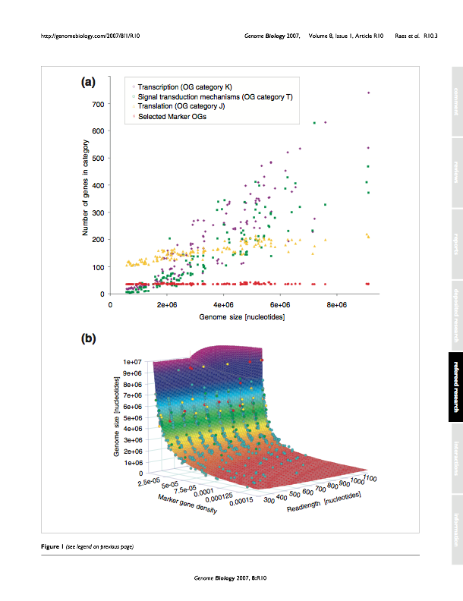
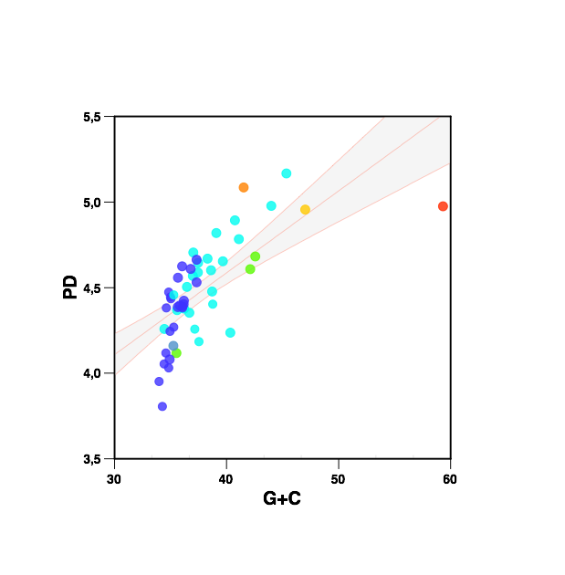
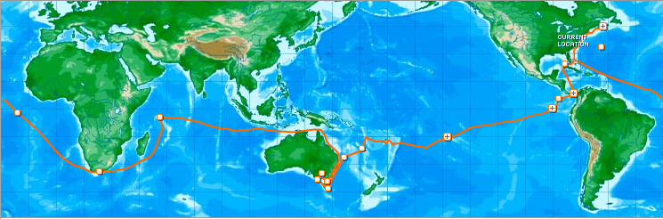
FUNCTIONAL TRAIT-BASED ANALYSIS OF AQUATIC MICROBIAL COMMUNITIES

Slide 48
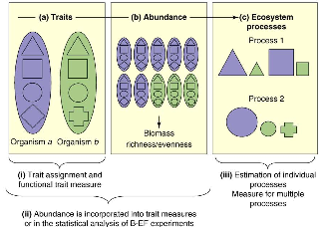
Functional Traits
A functional trait is a well-defined, measurable property of organisms that strongly influences performance.
Direct link to ecosystem functioning
Ecological trade-offs
What organisms
do,
how many types are needed to maintain ecosystem functioning
Reiss et al. (2009)
Notes:
What organisms do, and how many types are needed to maintain ecosystem functioning, rather than which and how many species are present.
Direct link to ecosystem services or ecological strategies
Biodiversity and ecosystem functioning
1) Traits are a measurable property of an organism
2) GC content (or percentage of GC) is one measurable molecular trait
3) If you take a number of traits together and stick them through something like PCA you can start to see multivariate correlations between traits and particular ecosystems

Slide 49
Examples of Metagenomic Traits
GC (Guanine-Cytosine) content (mean and variance):
Related to genome size, environmental complexity and community composition.
Functional and phylogenetic diversity:
Related to metabolic potential, community composition and environmental biogeochemistry.
Dinucleotide frequency:
Related to phylogenetic composition.
Explore community traits as ecological markers in microbial metagenomes. (Barberan, Fernandez et al. 2012).
Notes:
1) Traits are a measurable property of an organism
2) GC content (or percentage of GC) is one measurable molecular trait
3) If you take a number of traits together and stick them through something like PCA you can start to see multivariate correlations between traits and particular ecosystems
Genetics Having a pair of each type of chromosome, so that the basic chromosome number is doubled: diploid somatic cells.
(Barberan et al 2012),
*The percentage of Guanine-Cytosine. DNA with high GC-content is more stable than DNA with low GC-content and is postulated to play a role in adaptation to temperatures.
Examples of metagenomic traits:
- GC content (mean and variance) : Related to genome size, environmental complexity and community composition.
- Functional and phylogenetic diversity: Related to metabolic potential, community composition and environmental biogeochemistry.
Dinucleotide frequency: Related to phylogenetic composition.
A dinucleotide is just the pairing of two nucleotides, in DNA this is A paired with T, G paired with C- Number of genes/16S rRNA per genome: Related to growth rate and cellular stoichiometry and metabolic capability/complexity
A dinucleotide is a type of molecule found in living organisms and consists of two nucleotides linked together. Single nucleotides are the subunits that form deoxyribonucleic acid (DNA) and ribonucleic acid (RNA), molecules that contain an organism’s genetic information. Certain types of dinucleotides, such as nicotinamide adenine dinucleotide (NAD+), play an important role in metabolism.

Slide 50
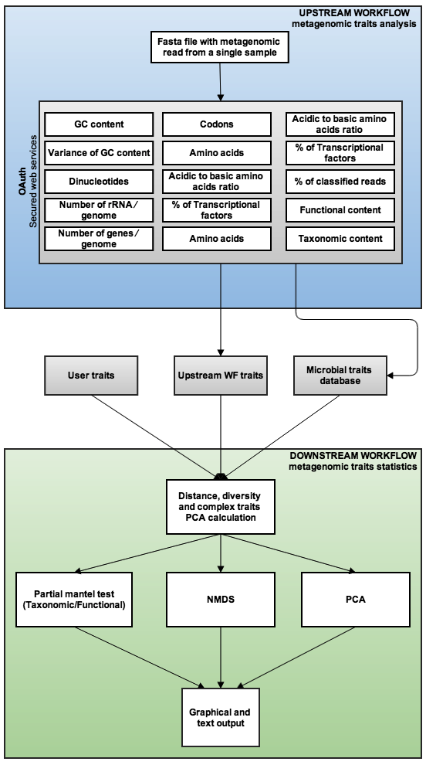
The Metagenomic Trait Workflow(s)
Upstream:
Calculating traits
(traits-analysis workflow)
Downstream
Calculating statistics
(traits-statistics workflow)
R scripts perform multivariate statistic analyses using the vegan package and plot the results using ggplot2
Notes:
Web services allow the calculation of traits like GC contents, ORF prediction, functional and taxonomic diversity

Slide 51
What is a Workflow?
Describes what you want to do, rather than how you want to do it
Simple language specifies how processes fit together
Predicted Genes out
Sequence
Repeat Masker
Web service
GenScan
Web Service
Blast Web Service

Slide 52
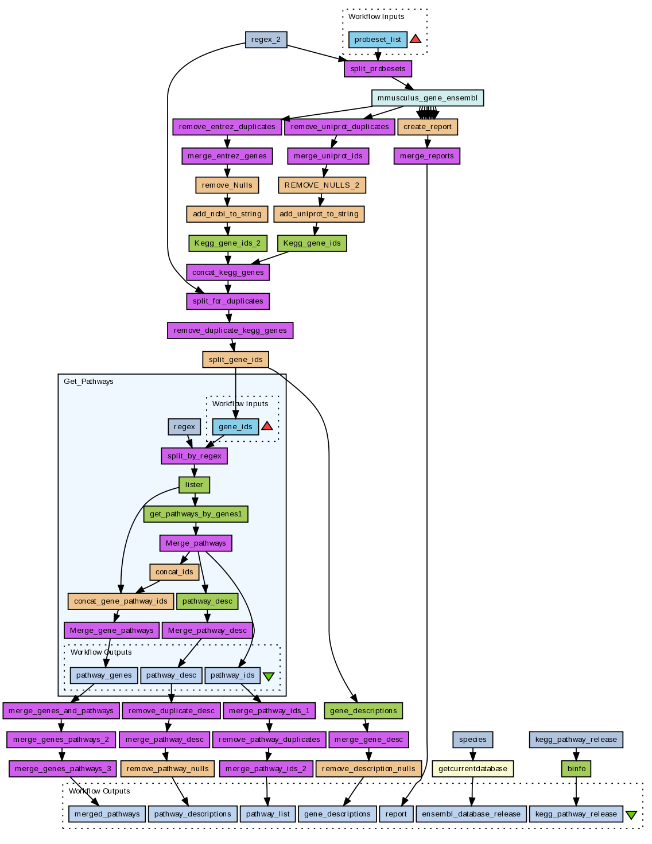

What is a Taverna?
Workflow management system
Sophisticated analysis pipelines
A set of services to analyse or manage data (either local or remote)
Data flow through services
Control of service invocation

Slide 53
Taverna Workflows
Enhance
Interoperability
Integration
and Collaboration
Ease
Access to distributed and local resources
Automation of data flow
Provenance
Function:
Experimental protocols
Notes:
53
53

Slide 54
Workflows can be good for…
High throughput analysis
Transcriptomics, proteomics, Next Gen sequencing
Data integration, data interoperation
Data management
Model construction
Data format manipulation
Database population

Slide 55
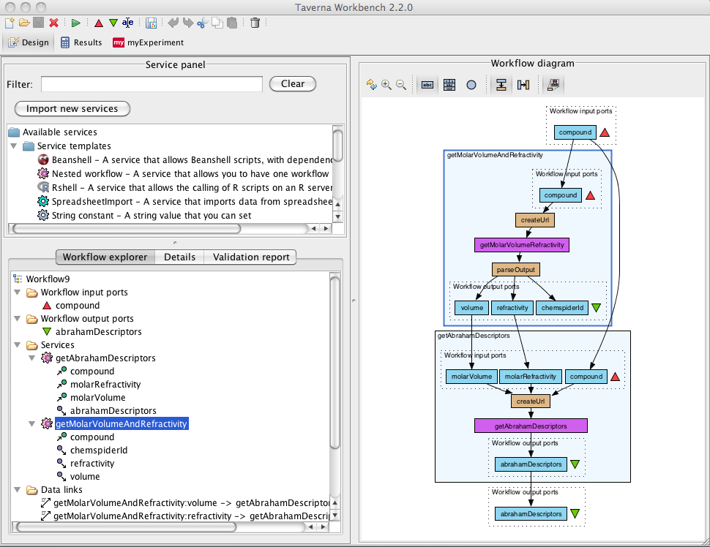
Taverna Workbench
Workflow engine
to run workflows
List of services
Construct and
visualise workflows
Web Services
e.g. KEGG
Scripts
e.g. beanshell, R
Programming
libraries
e.g. libSBML
Notes:
55

Slide 56
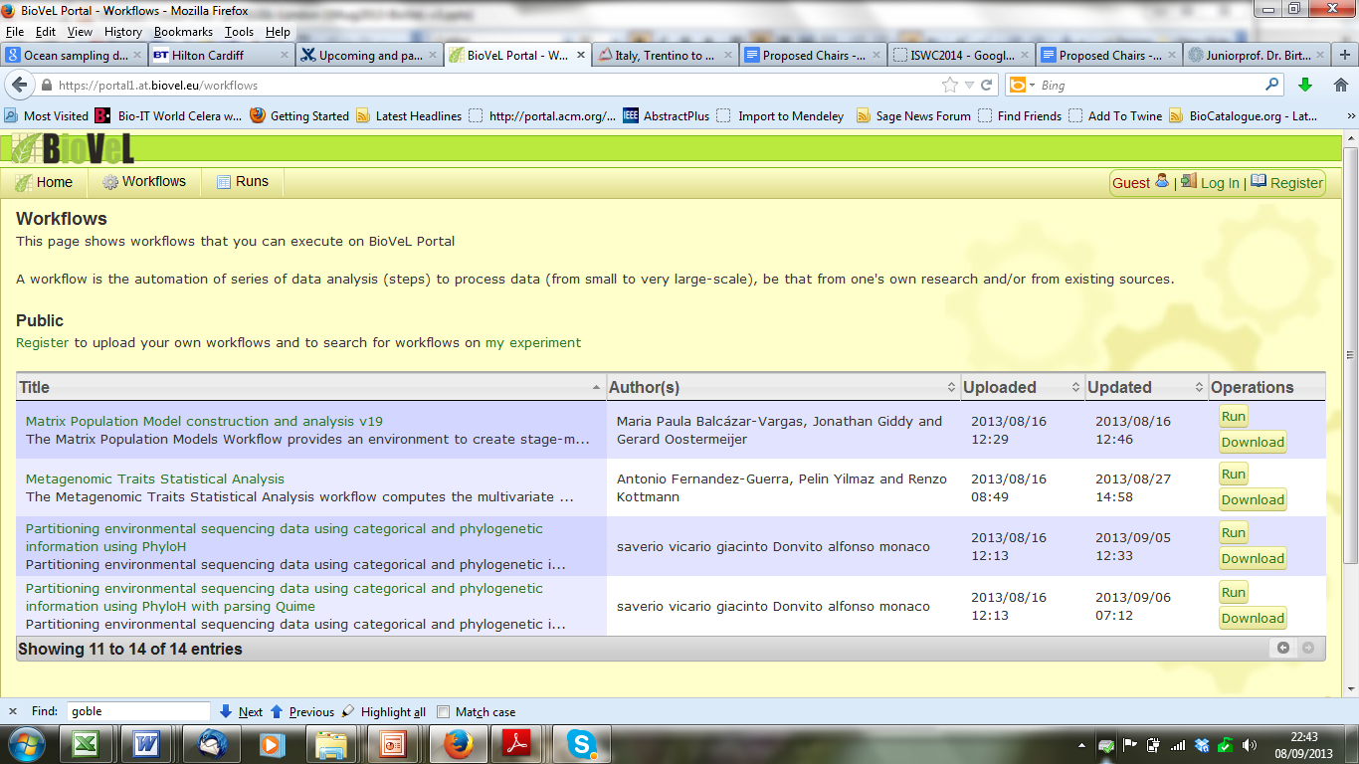

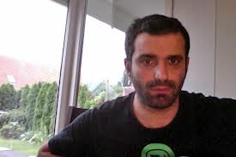
“Thanks to the workflow now everybody can do it.”
http://portal.biovel.eu/
Antonio Fernàndez-Guerra
Notes:
Auto-generated web interface to the workflow – general infrastructure

Slide 57
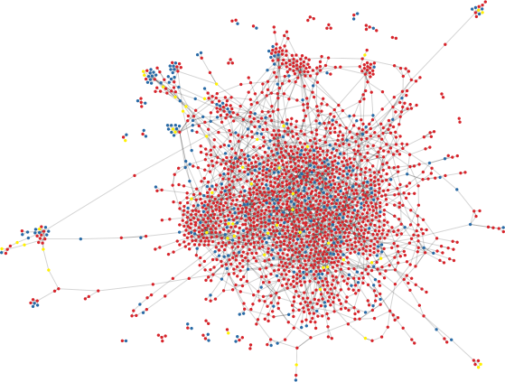

Discovery: knowns, known unknowns and unknown unknowns
Cluster1800572 Unknown unknown
SAR11_0487 Tryptophan synthase
SAR11_1266 hypothetical protein
SAR11_0686 hypothetical protein
SAR11_1277 aspartate racemase
Pelagibacter ubique proteome centered subnetwork Antonio Fernandez, submitted

Slide 58
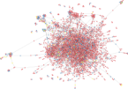

Information System: Process View
Scientists
Generate +
= knowledge

Slide 59
Act Interpret

Slide 60
Complexity
The real world is complex.
Data reflects the real world
and we have to deal with it.

Slide 61
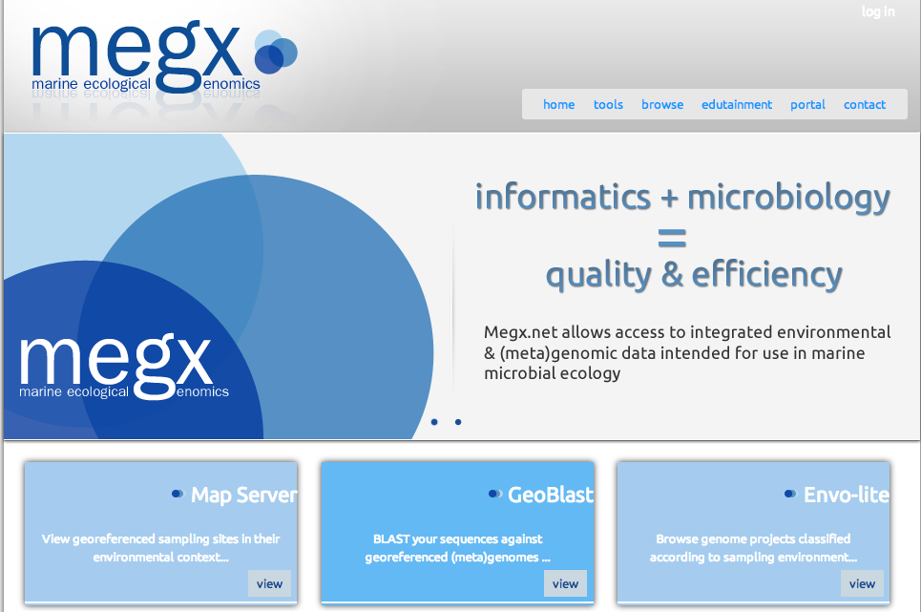

Data Access: Software Services

Slide 62
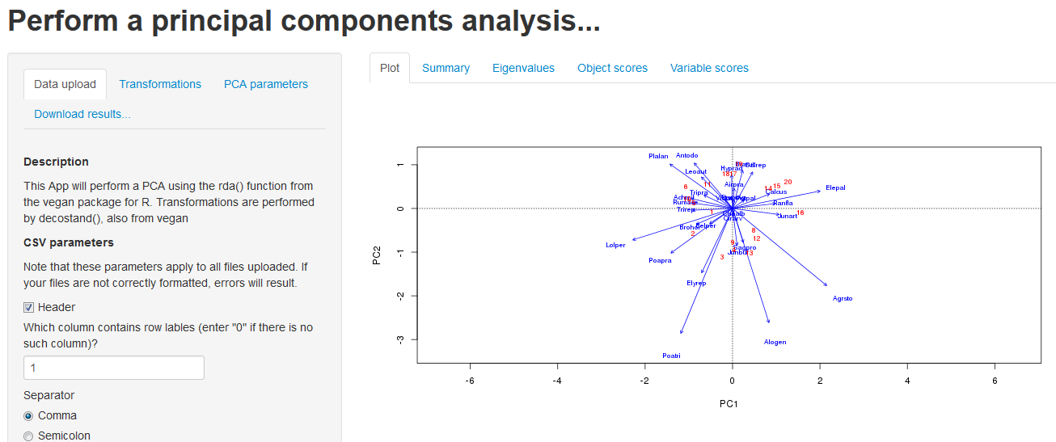
Ecological Analysis Tools for Microbial Ecology (EATME)

Slide 63
Metagenomic Network Analysis
Enable community of scientists to interact with the data
Cluster1800572 Unknown unknown
SAR11_0487 Tryptophan synthase
SAR11_1266 hypothetical protein
SAR11_0686 hypothetical protein
SAR11_1277 aspartate racemase

Slide 64
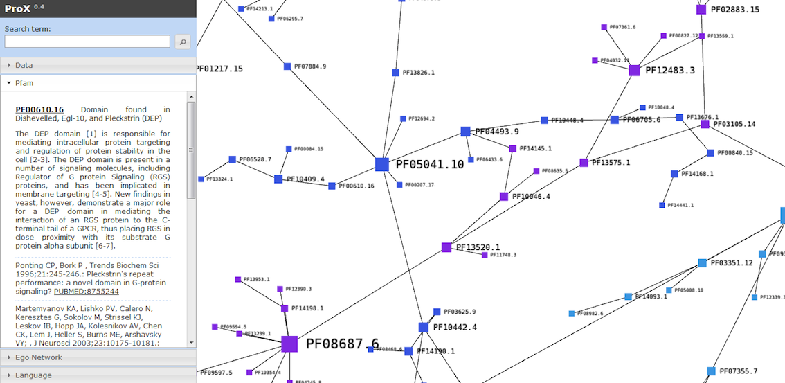
Data Access: Visualization of unknown networks

Slide 65
ProX
Master Thesis: Matthias Stock (Hochschule Bremen)
Efficient web-based and large-scale visualization of networks
Outperforms state of the art web tools

Slide 66
Information System: Process View
EATME
Scientists
Generate +
= knowledge

Slide 67
Information System: Process View
Which data? How to process and analyze?
What is the geographic and environmental distribution of my gene?
EATME
Scientists
Generate +
= knowledge
Data Tracking:
OSD App
OSD Server
Data Services:
Workflows
EATME
ProX

Slide 68
Take home messages
Information Systems
Integrated set of tools
Keep the data flowing
Added value services
Cut down data preparation time and costs

Slide 69
Outro

Slide 70
Megx.net / Micro B3 is Open Source
Subversion
https://projects.mpi-bremen.de/micro-b3/svn/
Source Code Browser
https://colab.mpi-bremen.de/source/
Wiki
https://colab.mpi-bremen.de/wiki
Issue Tracker
https://colab.mpi-bremen.de/its/

Slide 71

Thanks for your attention
http://www.microb3.eu
http://www.oceansamplingday.org
http://twitter.com/Micro_B3
1st Marine Board Forum: Marine data Challenges: from Observation to Information

Slide 72
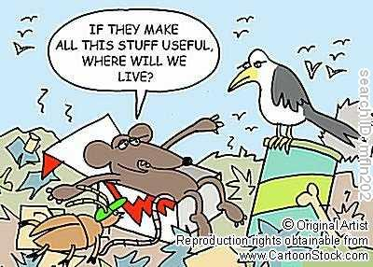

Slide 73
knowns
PFAM annotation of 53 GOS sampling sites (7523471 reads)
5653491 reads could have a PFAM assigned (15528086 hits)
unknowns
6-frame translation of 1869980 unknown reads (8884278 translated reads > 60aa)
Hierarchical clustering: 90%: 7681220 60%: 6689553 5759646 singletons removed929907 unknown unknowns
PFAM: 6903 (13672)Unknowns: 9925 (929907)
16S rDNA: 347 (7119)
16S rDNA
9190 16S rDNA (7119 @ 97%)
Global Ocean Sampling Expedition metagenomes
IV. Proof of concept
73

Slide 74
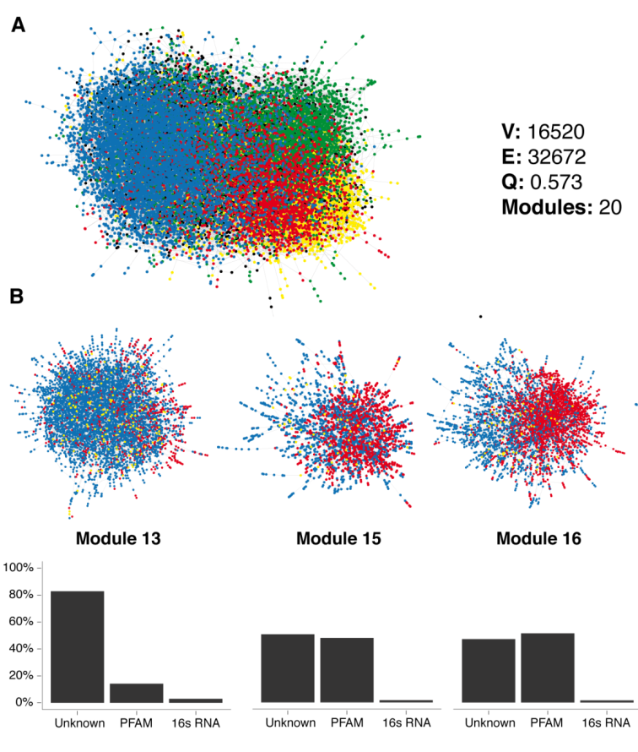
Network Analysis
Graphical Gaussian Model
Co-occurrence of unknown and known genes
Techniques similar to Web 2.0 social network analysis

Slide 75
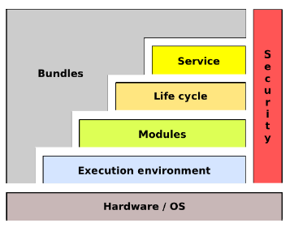
OSGi framework
Bundles (modules)
Execution environment
Application life cycle
Services
Service registry
Application share same JVM
Isolation/security

Slide 76
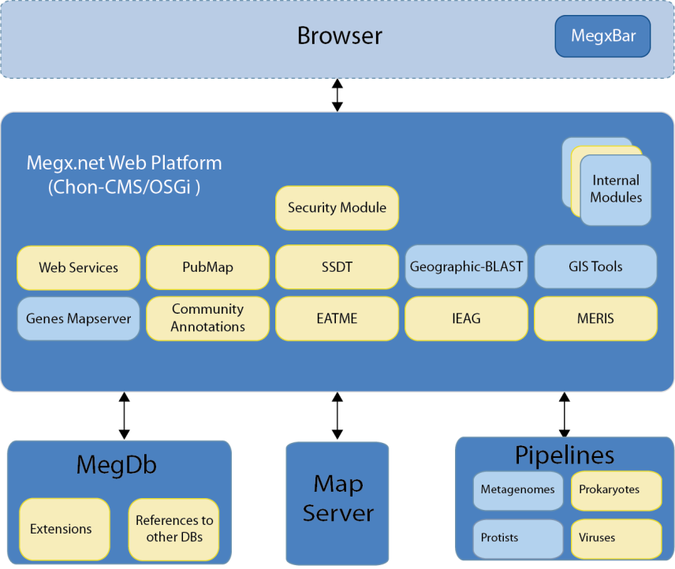
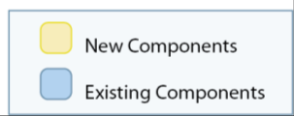
Components
~ 20 components
> 50 OSGi bundles
Should be devided in > 100

Slide 77
Guiding basic ecological questions
“Who is out there and where?”
In terms of sequenced genomes and key genes
In terms of gene profiles
“What can they do?”
In terms of gene functions
“Under which environmental conditions?”
information system, an integrated set of components for collecting, storing, and processing data and for delivering information, knowledge, and digital products. (http://www.britannica.com/EBchecked/topic/287895/information-system, last visit 2013-03-13)

Slide 78
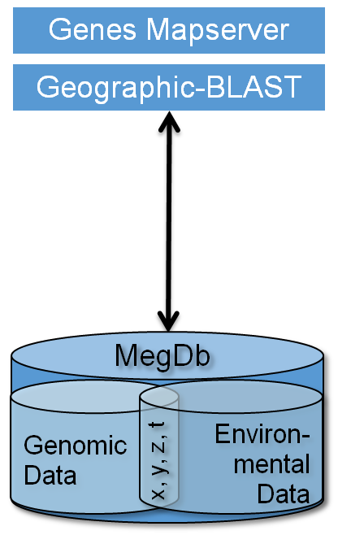
Megx.net: Data Portal for Microbial Ecological GenomiX
Integrates geo-referenced data on
Bacterial-, archaeal-, phage- Genomes
Metagenomes, and
16S rDNA based diversity data
Offers web based tools for visualization and analysis
http://www.megx.net
Kottmann et al. NAR. 2010
Notes:
megx.net

Slide 79
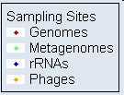
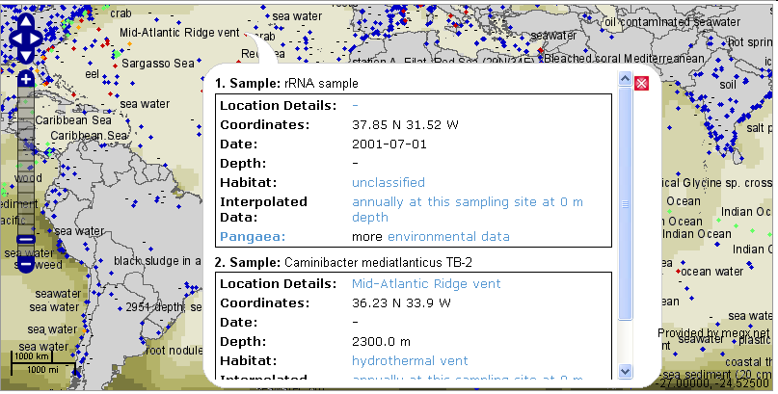
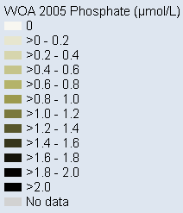
Who is out there and where? (in terms of sequenced genomes, metagenomes and key genes)
Kottmann et al. NAR 2010

Slide 80
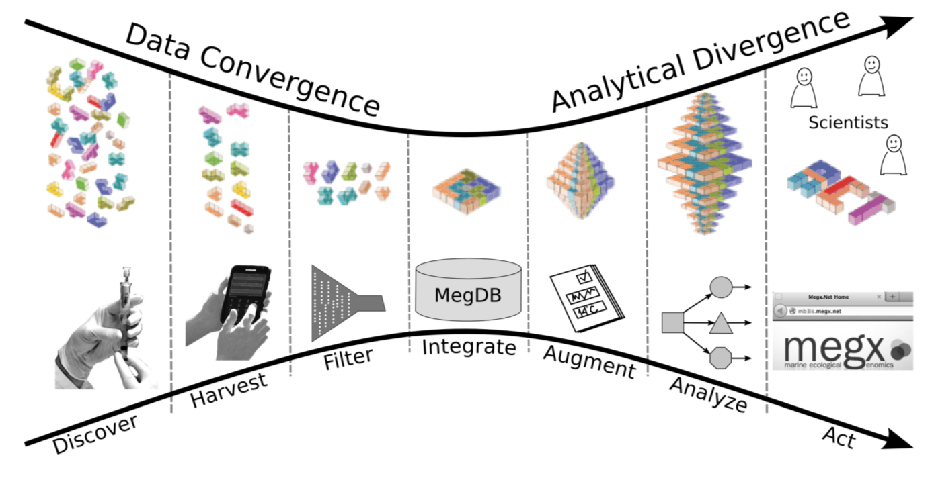



Micro B3 Information System

Slide 81
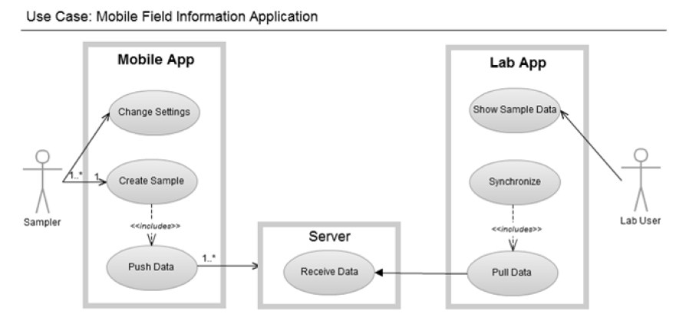
Contextual Data Flow – Mobile App

Slide 82
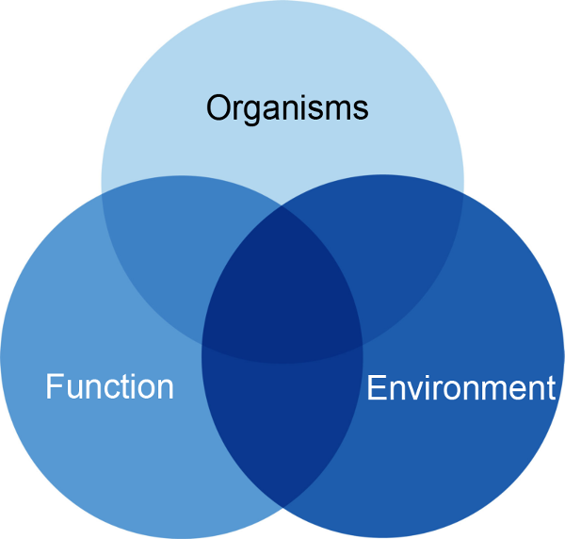
Exploring Ecosystems Biology
Knowledge
x, y, z, t
Key parameters
Statistics
Modelling
Predictions

Slide 83
Acknowledgements
Micro B3 Partners
Bremen: MPI, AWI, Marum, University Bremen, Jacobs University
WP Bioinformatics: EBI, Interworks, CNRS
Microbial Genomics Group
Frank Oliver Glöckner
Julia Schnetzer, Antonio Fernandez-Guerra, Michael Schneider
Pelin Yilmaz, Pier Luigi Buttigieg, Ivalyo Kostadinov
Genomic Standards Consortium

Slide 84










Micro B3: Connected
Notes:
MIRADA Microbial Inventory Research Across Diverse Aquatic Long Term Ecological Research Sites

Slide 85






Challenges in Environmental Bioinformatics
Data
Quantity
Complexity
Heterogeneity
Notes:
Kein Datenproduktionsproblem
Datenverarbeitungsproblem
Zu Viel...
BGI Gigascience
High Level Problem statement
Future
Data intensive
Molecular revolution

Slide 86


Problems
Data processing
Data management/ Standardisation
Quality management
Data integration/ Modelling/Prediction
Access/Visualization
Notes:
Nicht wirklich neu...

Slide 87
Data Integration: Marine Ecological Genomics Database (MegDb)
Genomic Databases
Environmental Databases
EMBL
CAMERA
World Ocean Atlas
GenBank
NCBI Genome Projects
World Ocean Database
DDBJ
RefSeq
SeaWiFS
Gold
Moore Genomes
Others
Extract, Transform, Load
Extract, Transform, Load
Geo-referencing
x = longitude
y = latitude
z = depth
t = time

Slide 88

Types of Sequence Data
Genomic DNA
Stores hereditary information
Encodes information as a sequence of 4 different bases:
Adenine, Thymine, Cytosine, Guanine
Example: ACGATCGACTGAC
Alphabet size = 4, up to 15
Lengths between few thousands and billions
Genomic DNA can be repetitive

Slide 89

Types of Sequence Data
Short Sequences
Short read DNA
From 50 to 10,000 bases long
RNA
Similar to short read DNA
Protein
Alphabet of 20 to 23!
At maximum thousands long

Slide 90

Kilobyte per Day per Machine
Notes:
ca. 50 – 100 GB per day per machine

Slide 91
PostBIS: Sequence Data Compression
Master Thesis: Michael Schneider
PostgreSQL extension
In-database sequence compression
Special Data Types
Special Functions

Slide 92

PostBIS Performance
Short again
Genomic DNA
Short
Alignments

Slide 93

PostBIS Performance

Slide 94

PostBIS Performance

Slide 95

Substring Performance

Slide 96

Substring Performance

